Slide 1
Stroke Risk Factors: Insights from Demographic, Lifestyle, and Health Data
Final Project
Exploratory Data Analysis (EDA)
Itzhak Moradov

Slide 2
Dataset (Link)
Column | Data type | Attribute Information
id | Int | Unique identifier
gender | Object (string) | "Male“/"Female"
age | float | Age of the patient
heart_disease | Int | 0 - If the patient doesn't have any heart diseases. 1 - If the patient has a heart disease
ever_married | Object (string) | ‘Yes’/’No’
Residence_type | Object (string) | "Rural" /"Urban"
avg_glucose_level | float | Average glucose level in the blood
bmi | float | Body mass index
smoking_status | object | "formerly smoked“/"never smoked“/"smokes“/ "Unknown"
stroke | Int | 0 - If the patient didn’t have a stroke. 1 - If the patient had a stroke.

Slide 3
Assumptions & Questions
Assumptions
Questions
Gender Differences: The incidence of stroke varies between males and females.
Age and Stroke Risk: Older individuals are at a higher risk of experiencing a stroke.
Heart Disease and Stroke: There is a higher incidence of stroke among those with heart disease.
Marital Status and Stroke: Being married (ever married) influences the likelihood of having a stroke.
Residence Type and Stroke: Urban residents have a different stroke risk profile than rural residents.
Glucose Levels and Stroke: Higher average glucose levels correlate with an increased stroke risk.
BMI and Stroke: There is a relationship between BMI (Body Mass Index) and the incidence of stroke
Smoking and Stroke: Smoking status significantly impacts the likelihood of having a stroke.

Slide 4
Assumptions & Questions
Questions
Assumptions
How does stroke incidence vary between males and females?
What is the distribution of stroke occurrences across different age groups?
How does the presence of heart disease affect the likelihood of a stroke?
Does marital status (ever married vs. never married) influence the risk of stroke?
Is there a difference in stroke rates between urban and rural residents?
How do average glucose levels correlate with stroke occurrences?
How does BMI relate to the likelihood of having a stroke?
Is there a relationship between smoking status and stroke incidence?

Slide 5
Statistical Analysis Interpretation
Null Hypothesis (H0): There is no difference/ significant association between the two (or more) groups.
Alternative Hypothesis (H1): There is a difference/significant association between the two (or more) groups.
Chi-Squared Test of Independence –
For Categorial Groups
T-test
Cohen's d
α (significance level) = 0.05
p-value > α : Accept null hypothesis
p-value < α : Reject null hypothesis
α (significance level) = 0.05
p-value > α : Accept null hypothesis
p-value < α : Reject null hypothesis
Effect size | d
Very small | 0.01
Small | 0.2
Medium | 0.5
Large | 0.8
Very large | 1.2
Huge | 2.0

Slide 6
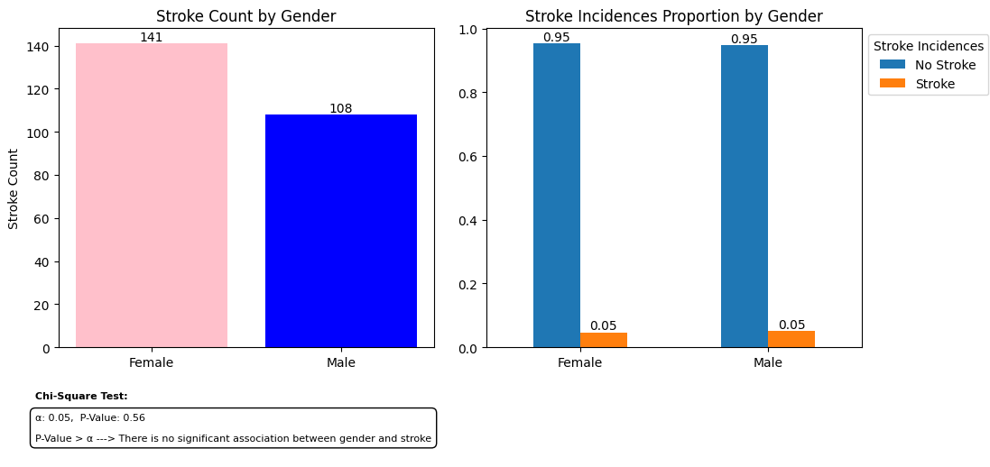
Data Analysis – Stroke & Gender Correlation
Conclusion:
Based on the current data, gender does not appear to be a statistically significant factor (p-value=0.56) in stroke incidence.
Moreover, the proportion of incidents is the same for both groups

Slide 7
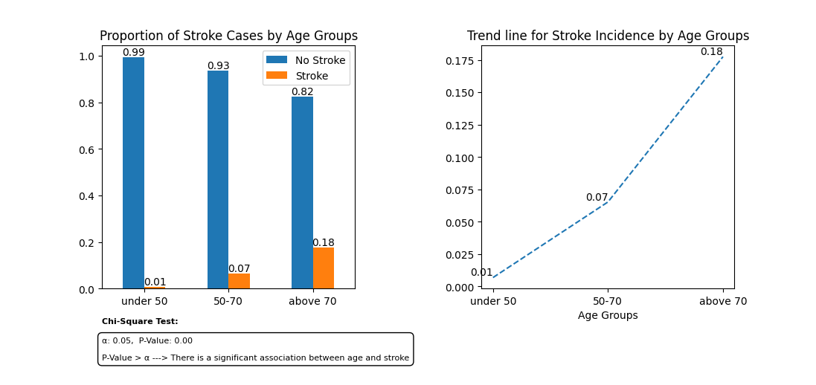
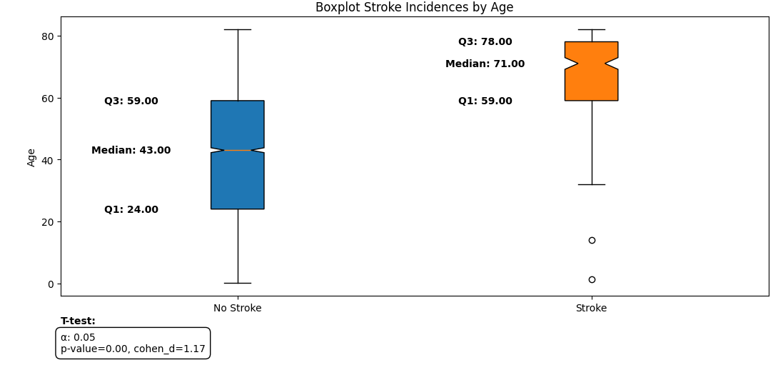
Data Analysis – Stroke & Age Correlation
Conclusion:
Both statistical tests indicate age is a significant factor in stroke incidence(p<0.05), with a large effect size (Cohen’s d=1.17).
Individuals who have experienced a stroke are significantly older than those who have not.
Less age variability among stroke patients compared to individuals who have not experienced a stroke.

Slide 8
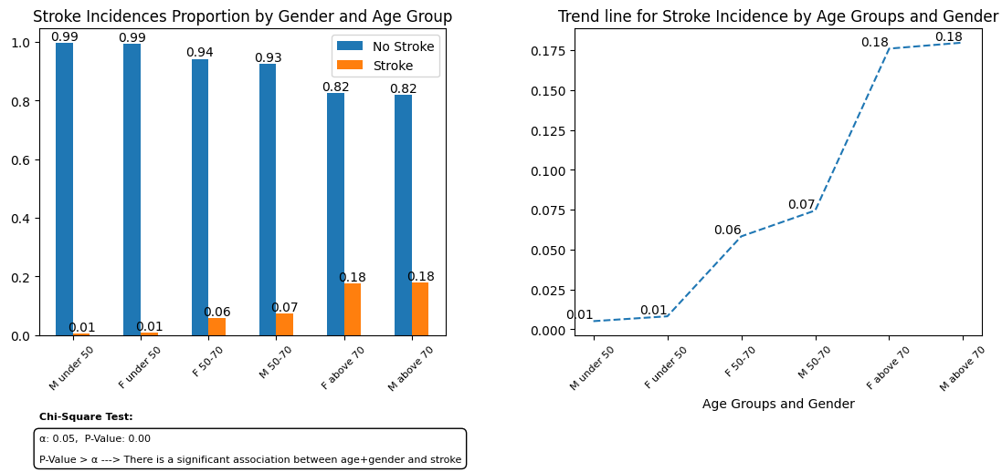
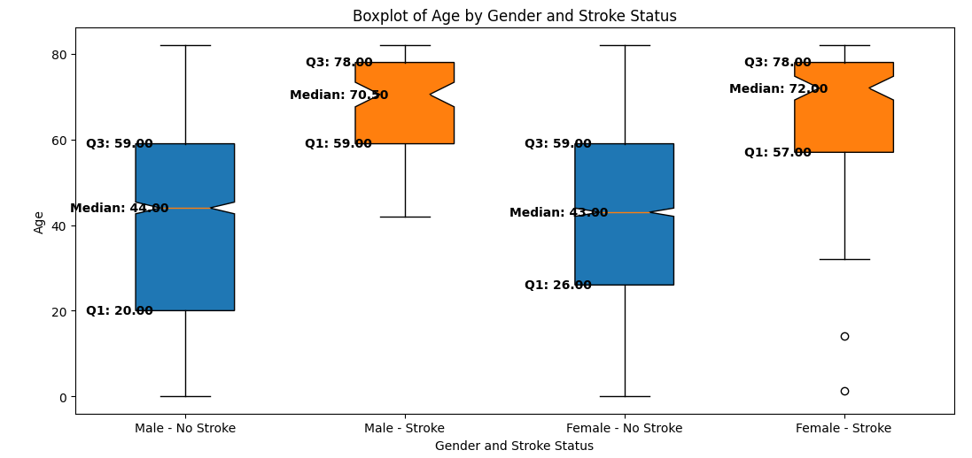
Data Analysis – Stroke & Age + Gender Correlation
Conclusion:
As was shown previously, the proportion of incidents is the same for both groups, and the age range is the main significant factor in stroke incidences.

Slide 9
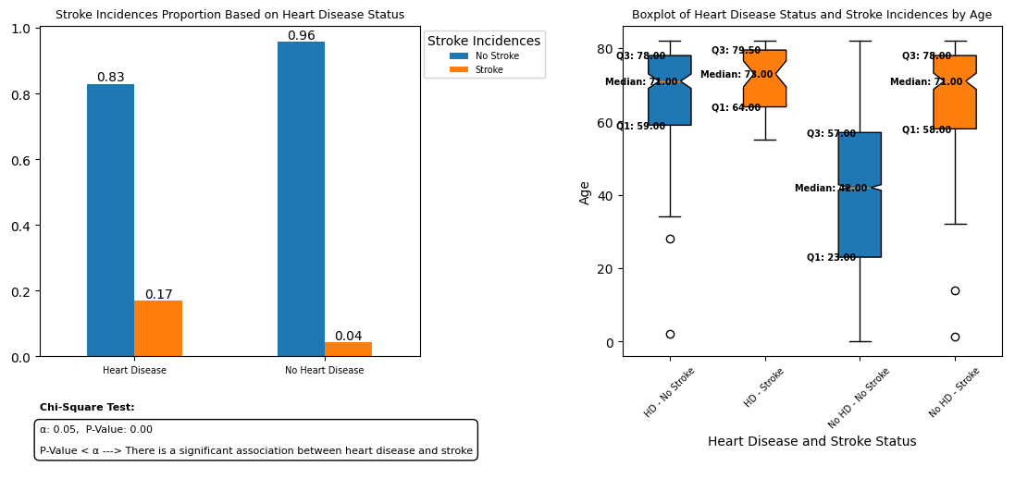
Data Analysis – Stroke & Heart Disease Correlation
Conclusion:
There is a significant relationship between heart disease and stroke incidences, as indicated by the p-value < 0.05
Age distribution suggests that the presence of heart disease is significant among older adults.
Heart disease is a significant risk factor for stroke, with those affected being older on average compared to those without heart disease.

Slide 10
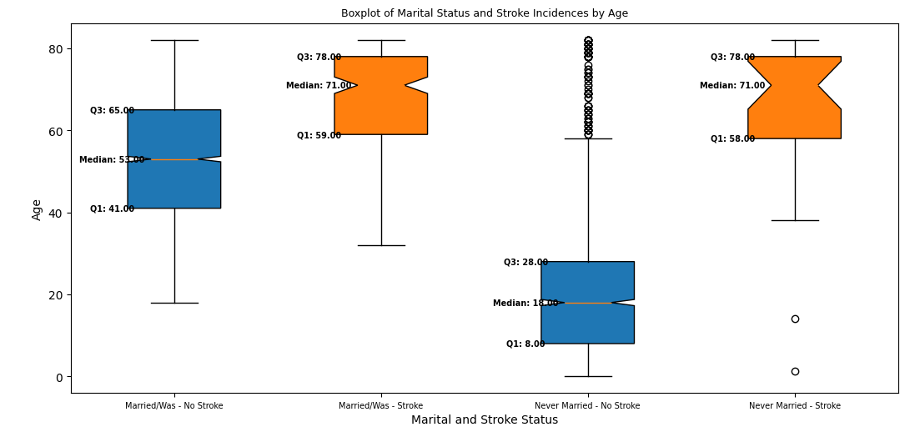
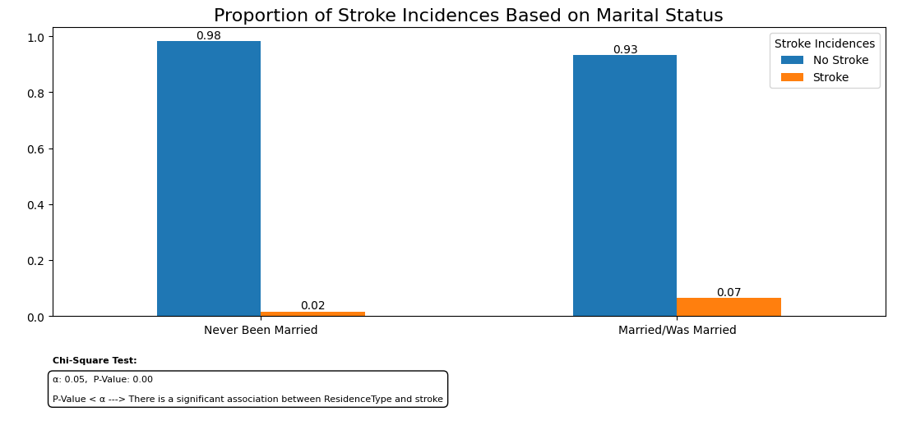
Data Analysis – Stroke & Marital Status Correlation
Conclusion:
There is a significant relationship between marital status and stroke incidence, as indicated by the p-value < 0.05; however:
Marital status appears to have an indirect relationship with stroke incidents, likely influenced by age. The non-married group includes a much younger population who are less likely to have strokes - Marital status may not be a direct risk factor but can indicate different age demographics that need tailored approaches.

Slide 11
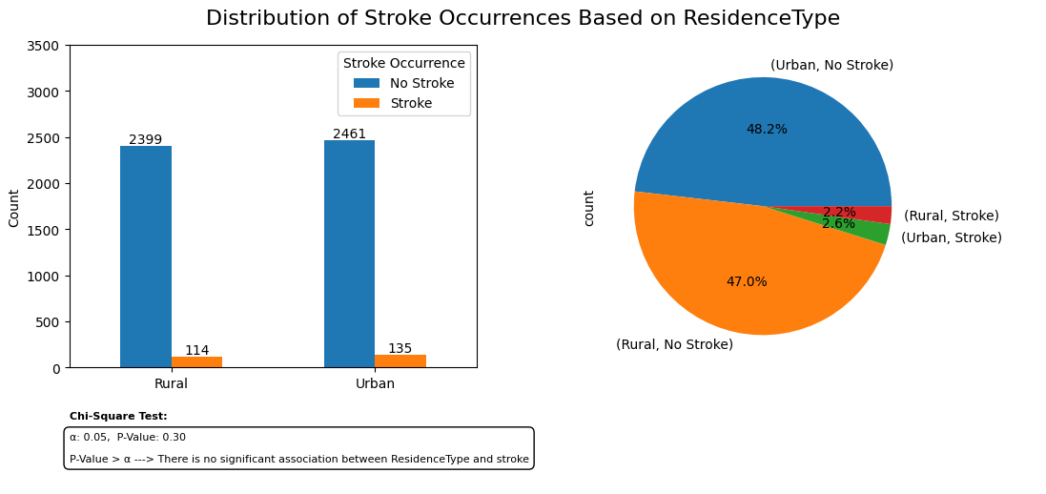
Data Analysis – Stroke & Residence Type Correlation
Conclusion:
Residence type does not appear to be a statistically significant factor in stroke incidence.

Slide 12
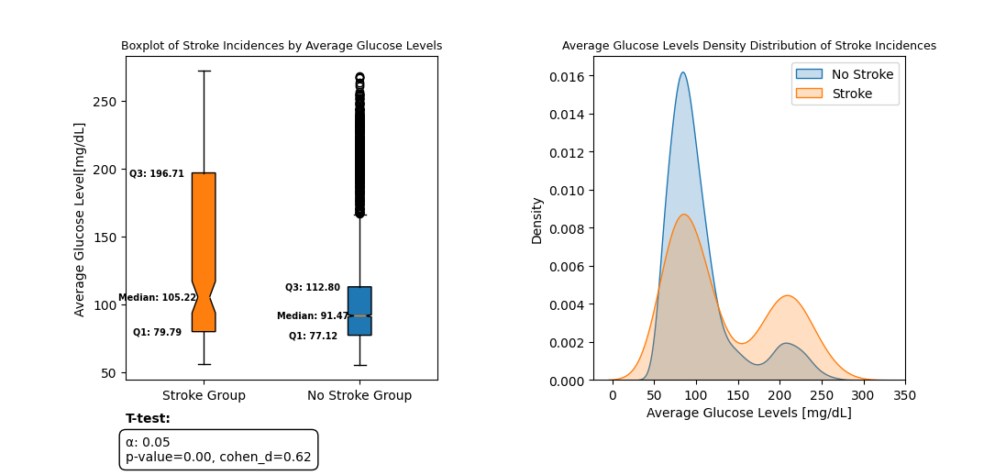
Data Analysis – Stroke & Average Glucose Levels Correlation
Conclusion:
There is a statistically significant difference in average glucose levels between individuals who have had a stroke and those who have not, with a medium to large effect size (Cohen’s d=0.62)
The stroke group also exhibits a wider range of glucose levels, particularly with a higher upper quartile (Q3 = 196.71 mg/dL) compared to the no-stroke group (Q3 = 112.8 mg/dL)

Slide 13
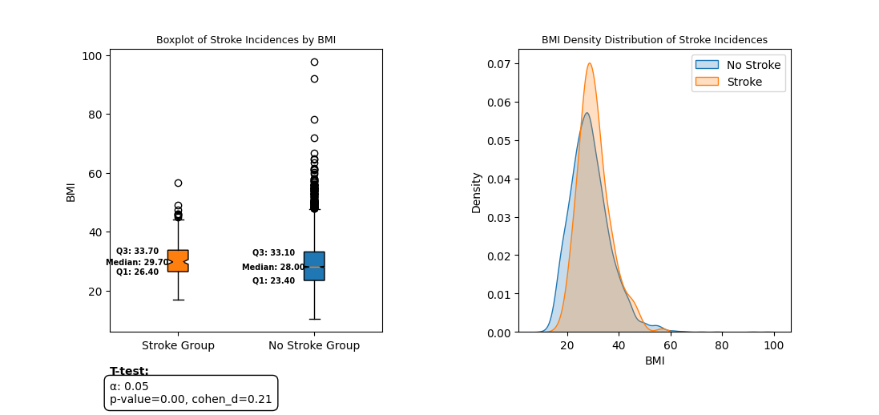
Data Analysis – Stroke & BMI Correlation
Conclusion:
While BMI seems to be statistically significant in stroke incidents with more density for the stroke group with higher BMI, the small effect size (Cohen’s d=0.21) and the almost identical distribution suggest that BMI alone is not a strong predictor of stroke risk. It may be one of several contributing factors.

Slide 14
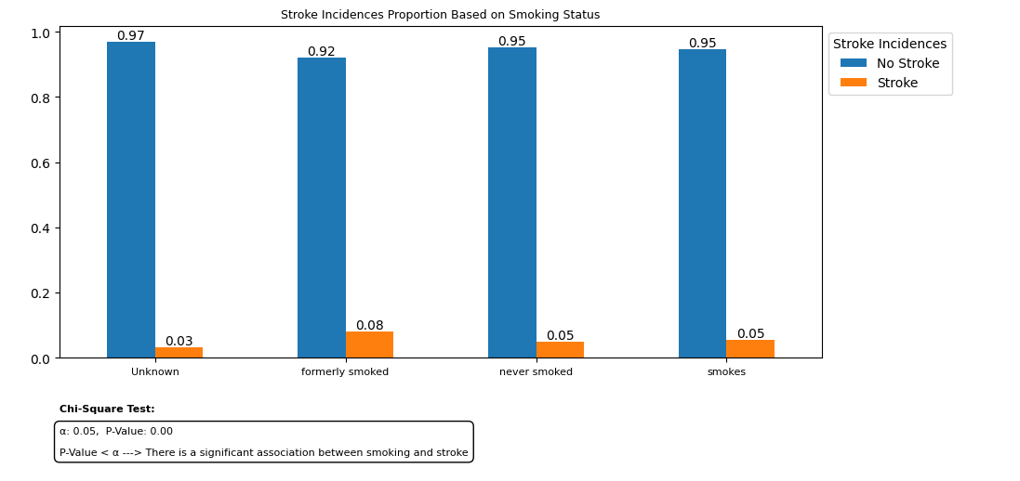
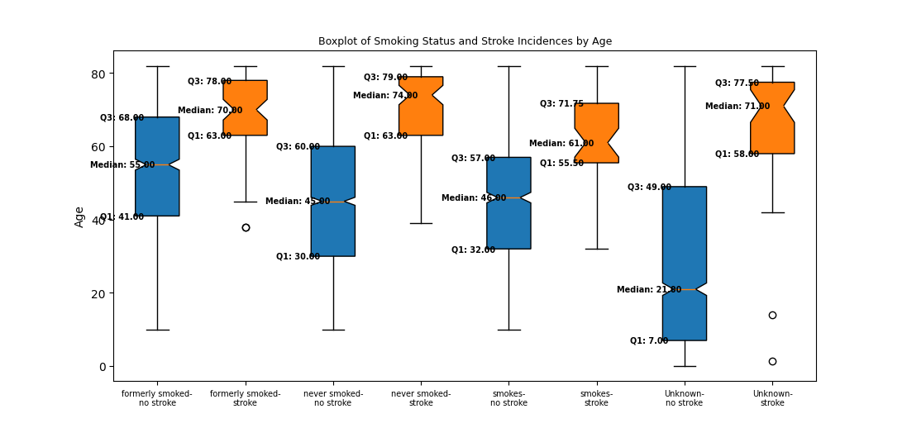
Data Analysis – Stroke & Smoking Status Correlation
Conclusion:
Smoking status is significantly related to stroke incidents (p-value < 0.05).
Current smokers tend to have strokes at younger ages compared to the other groups and relative to the stroke group in the stroke vs. age analysis.

Slide 15
Summary
Risk Factor | Correlate to Stroke | Statistical Significant Relationship
Gender | No | P=0.56
Age | Yes | P=0.00
Heart Disease | Yes | P=0.00
Marital Status | Yes | P=0.00 Marital status appears to have an indirect relationship with stroke incidents, likely influenced by age
Residence Type | No | P=0.3
Avg Glucose Level | Yes | P=0.00 Cohen’s d=0.62
BMI | Yes | P=0.00 Cohen’s d=021
Smoking Status | Yes | P=0.00
stroke | Int | 0 - If the patient didn’t have a stroke. 1 - If the patient had a stroke.
Link to python code: GitHub

Slide 16


